Slide 1
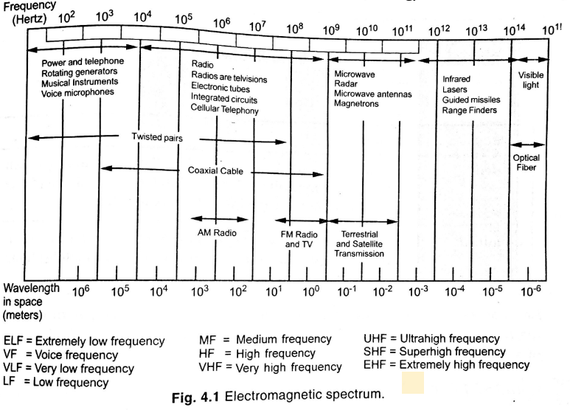
Electromagnetic Spectrum for Communication

Slide 2
Advantage of low frequency
Low attenuation hence can reach up-to longer distance.
Large wavelength can be diffracted through earth surfaces.
The longer the wavelength, the further a signal can penetrate through solid objects or liquid( eg sea water).
Vertically polarized wave is guided by earth surface.
Advantage of High frequency
High available b/w
High antenna efficiency.
High antenna gain
Less interference and less noise effect
Less crowded spectrum.
Narrow beam width
Low diffraction Less absorption

Slide 3
Types of propagation
Ground waves:
electromagnetic waves are propagated along the surface of earth.
Usually use low frequency.
AM and maritime communication are examples.
Sky waves:
electromagnetic waves are propagated through the sky and get reflected back to the earth from the ionosphere,
Usually high frequency.
Application in broadcast and long distance communication.
Space waves:
electromagnetic waves propagate from the transmitter antenna to the receiver antenna without any reflection or refraction,.
Usually use very high frequency.
Line of site between receiver and Transmitter is required.
Application in MW link and space communication.

Slide 4
Guided Media
Exists physical medium through which the signals are transmitted from source to destination.
Signal is constrained on that physical media.
Types Of Guided media:
Twisted pair:
twisted pair consists of two insulated copper wires arranged in a regular spiral pattern
The frequency range for twisted pair cable is from 0 to 3.5KHz.
Twisting is done to make sure the noise will equally affect the wire from the external environment and also reduce cross coupling eliminating field generation. Current flowing in opposite direction reduces field generation.
The degree of reduction in noise interference is determined by the number of turns per foot.

Slide 5
Unshielded Twisted Pair Cable
UTP cable is a 100 ohm copper cable that consists of unshielded twisted pairs surrounded by an outer protective plastic jacket .
They have no metallic shield. This makes the cable small in diameter but unprotected against electrical interference.
The twist helps to improve its immunity to electrical noise and EMI.
Advantages Of Unshielded Twisted Pair:
It is cheap.
Installation of the unshielded twisted pair is easy.
Disadvantage:
This cable can only be used for shorter distances.
Susceptible to external interference

Slide 6
Shielded Twisted Pair Cable
This cable has a metal foil covering which encircle the pair of insulated conductors.
Electromagnetic noise penetration is prevented by metal casing.
Shielding also eliminates crosstalk
Advantages of Shielded Twisted Pair Cable
Higher capacity than unshielded twisted pair
Eliminates crosstalk
It is shielded that provides the higher data transmission rate.
Disadvantages of Shielded Twisted Pair Cable
Difficult to manufacture
Comparatively heavy and expensive.

Slide 7
Co-axial cable
it contains two cylindrical conductors centered at a same axis
Copper is used in this as center conductor which can be a solid wire and carry signal
It is surrounded by PVC installation, a sheath which is encased in an outer conductor of metal foil, braid or both.
Outer metallic wrapping is used as a shield against noise.
It has a higher Bandwidth as compared to Twisted pair cable.
Advantages of Coaxial Cable
Bandwidth is high and impedance matching cause low signal loss.
Used in long distance telephone lines.
Transmits digital signals at a very high rate of 100Mbps.
Much higher noise immunity
Data transmission without distortion.
They can span to longer distance at higher speeds as they have better shielding when compared to twisted pair cable

Slide 8
Disadvantages of Coaxial Cable
Difficult to install and expensive when compared with twisted pair.
If the shield is imperfect, it can lead to grounded loop.
Applications:
Radio frequency signals are sent over coaxial wire.
It can be used for cable television signal distribution,
feedlines that connect radio transmitters and receivers to their antennas.

Slide 9
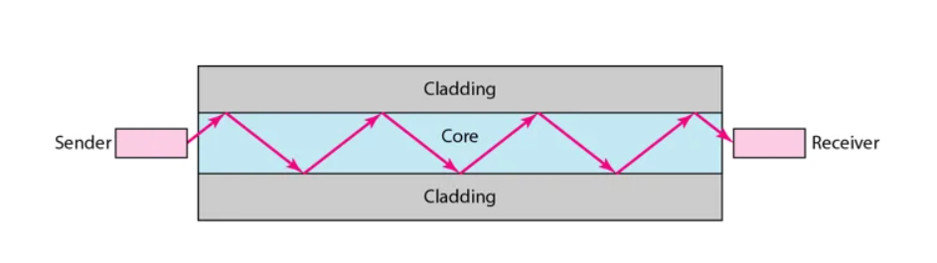
Optical fiber
Fiber-optic communication is a method of transmitting information from one place to another by sending pulses of infrared or visible light through an optical fiber.
the light is in the form of a carrier signal that is used to carry the data.
The fiber optic cables replace the electrical cables whenever long distance, high bandwidth, and resistance to electromagnetic interference are necessary.

Slide 10
Core inner narrow strand of glass or plastic known as a core. Light travel via this core and has high refractive index.
Cladding: The concentric layer of glass is known as cladding. The main functionality of the cladding is to provide the lower refractive index at the core interface as to cause the reflection within the core so that the light waves are transmitted through the core.
Jacket: The protective coating consisting of plastic is known as a jacket. The main purpose of a jacket is to preserve the fiber strength, absorb shock and extra fibre protection.
Following are the advantages of fibre optic cable over copper:
The fiber optic cable provides more bandwidth as compared copper. Therefore, the fiber optic carries more data as compared to copper cable.
Fiber optic cable carries the data in the form of light. This allows the fiber optic cable to carry the signals at a higher speed.
The fiber optic cable carries the data at a longer distance as compared to copper cable.
The fiber optic cable is more reliable than the copper cable as it is immune to any temperature changes while it can cause obstruct in the connectivity of copper cable.
Fiber optic cable is thinner and lighter in weight so it can withstand more pull pressure than copper cable.
Immune to electromagnetic interference
Suitable for industrial and noisy areas

Slide 11
Characteristics | Single-Mode Fiber | Multimode Fiber
Diameter of a Core | It has a small diameter core | It has a large diameter core
Source Optical | laser. | LED.
Bandwidth | High bandwidth | bandwidth is less
Fields | Long distance communication | Short distance communication
Modal Dispersion | The single-mode fibre contains a narrower modal dispersion. | Multimode fibre has a wider range of modal dispersion.
Light carrier | Single beam of light | Multiple beam of light
Cost | expensive. | low cost

Slide 12
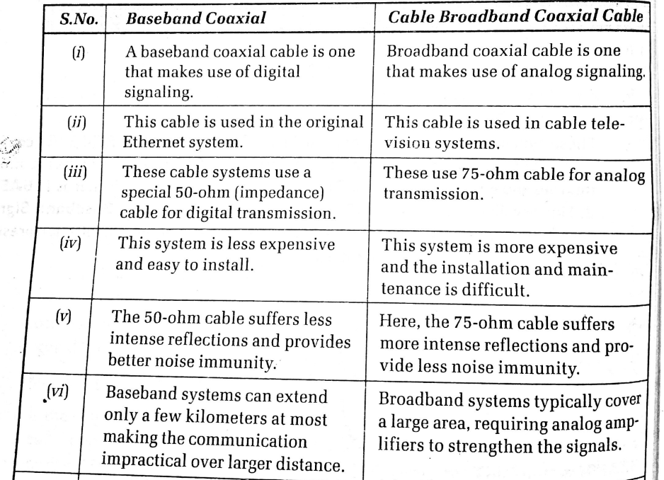

Slide 13
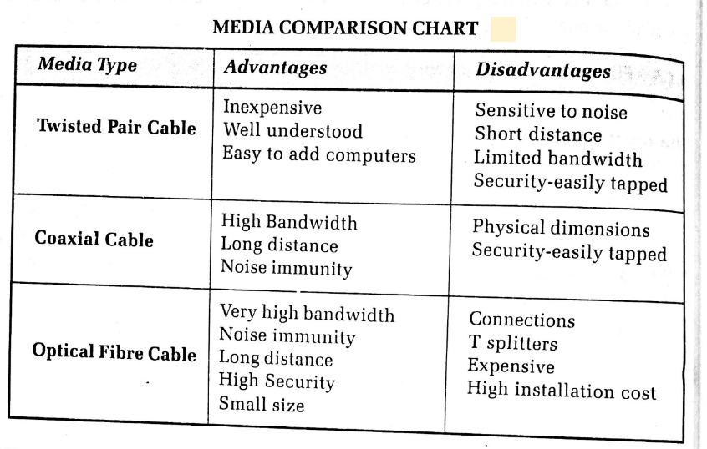

Slide 14
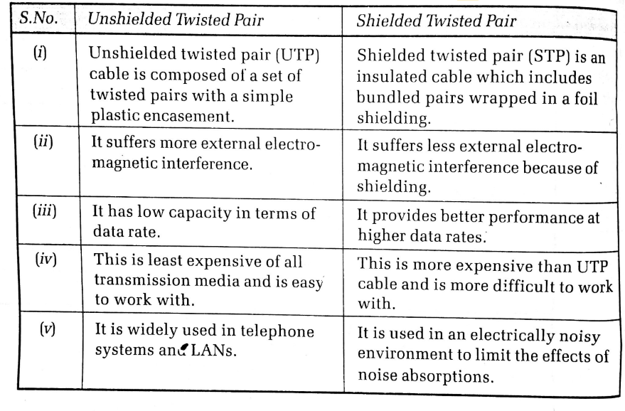

Slide 15
UnGuided Transmission media
transmits the electromagnetic waves between source and destination without using any physical medium.
Signal energy is distributed over a free space.
Types
Radio waves –
these are electromagnetic waves that may be transmitted in all directions in free space.
Radio waves are omnidirectional, which means that signals travel in all directions.
Radio waves have frequencies ranging from 3 Khz to 1 Ghz.
In the case of radio waves, the sending and receiving antennas are not aligned, thus the wave sent by the sending antenna can be received by any receiving antenna.
As radio transmission also uses sky propagation the signal can be broadcasted over a long distance
As the radio waves can penetrate walls and you can receive signals even if you are inside the building

Slide 16
Applications of Radio Waves:
When there is only one transmitter and numerous recipients, a radio wave is helpful for multicasting.
Radio waves are used by FM radio, television, and cordless phones.
Advantages of Radio Waves:
Radio transmission is mostly utilized for wide area networks and mobile phones.
Radio waves may penetrate barriers and cover a vast area.
Mobility in communication

Slide 17
Microwaves –
The microwave is the electromagnetic waves with frequency ranging from ‘1 to 300 GHz’.
The microwaves are unidirectional in nature and due to which it propagates in line-of-sight mode.
In line-of-sight propagation, the source transmitting antenna and the receiving antenna needs to aligned to each other in such a way that they must be facing each other which enables point-to-point transmission. These are majorly used for mobile phone communication repeater and television distribution.
Advantages of Microwave Transmission:
Microwave transmission is less expensive than cable transmission.
It does not need the acquisition of land since the installation of cables does not involve the acquisition of land..

Slide 18
The microwave transmission can be classified into two types:
Terrestrial Microwave Transmission In terrestrial microwave transmission, the transmitting and receiving antenna both are fixed on the ground and the signal wave is transmitted using the line of sight propagation mode.
It is mostly used for telecommunication.
Microwaves are electromagnetic waves with frequencies ranging from 1GHz to 1000GHz.
Satellite Microwave Transmission In satellite microwave transmission the electromagnetic wave is transmitted by the source transmitting antenna (earth station) which is received by satellite which amplifies the signal and rebroadcast it to the receiver antenna (earth station).
Satellite microwave transmission is mostly used for television, long-distance telecommunication, and global positioning system.

Slide 19
Infrared Transmission
Infrared wave is the high-frequency wave ranging from ‘300 GHz and above’.
The infrared transmission uses line-of-sight propagation and thereby is used for short-distance communication.
The most popular example of infrared transmission that we daily come across is your remote that you use to operate AC, television, music system, etc.
The remote emits infrared waves which are received by the television and according to perform the action.

Slide 20
DATA RATE LIMITS
A very important consideration in data communications is how fast we can send data, in bits per second, over a channel. Data rate depends on three factors:
1. The bandwidth available
2. The level of the signals we use
3. The quality of the channel (the level of noise)
Noiseless Channel: Nyquist Bit Rate
Noisy Channel: Shannon Capacity

Slide 21
Increasing the levels of a signal increases the probability of an error occurring, in other words it reduces the reliability of the system.

Slide 22
Capacity of a System
The bit rate of a system increases with an increase in the number of signal levels we use to denote a symbol.
A symbol can consist of a single bit or “n” bits.
The number of signal levels = 2^{n}.
As the number of levels goes up, the spacing between level decreases -> increasing the probability of an error occurring in the presence of transmission impairments.

Slide 23
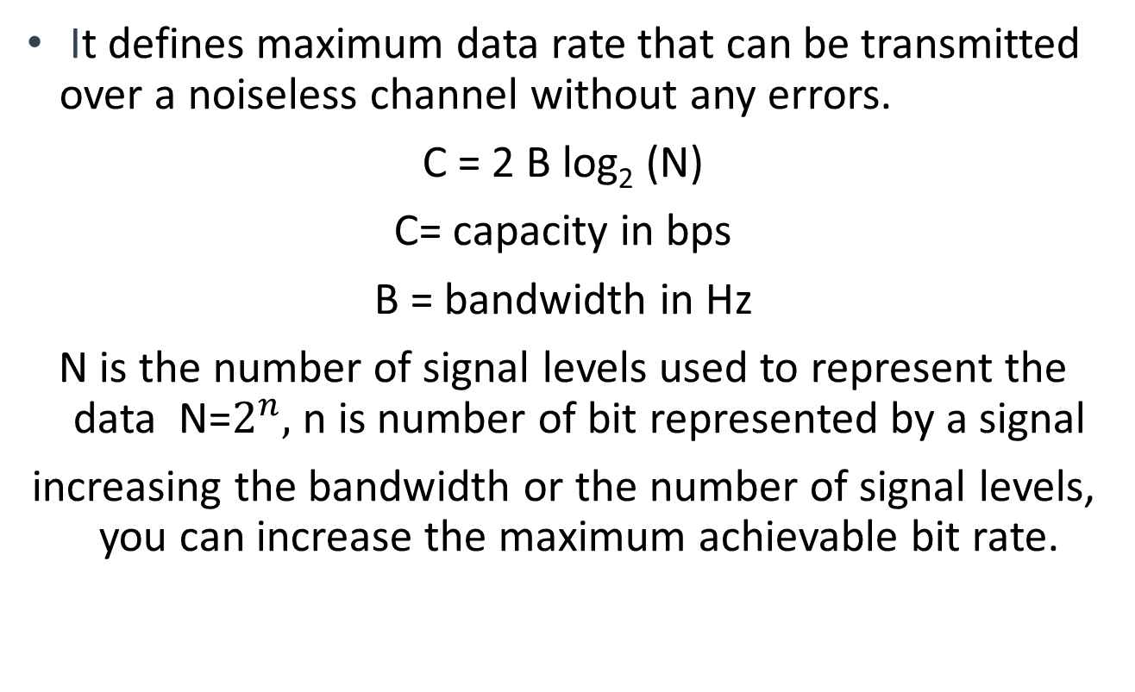
Nyquist Theorem
It defines maximum data rate that can be transmitted over a noiseless channel without any errors.
C = 2 B log₂ (N)
C= capacity in bps
B = bandwidth in Hz
N is the number of signal levels used to represent the data N=$2^{n},$n is number of bit represented by a signal
increasing the bandwidth or the number of signal levels, you can increase the maximum achievable bit rate.

Slide 24
Consider the same noiseless channel transmitting a signal with four signal levels (for each level, we send 2 bits). The maximum bit rate can be calculated as

Slide 25
Shannon’s Theorem
Shannon's theorem states that for a given communication channel with a certain level of noise, there exists a maximum achievable data rate, also known as the channel capacity.
The channel capacity represents the theoretical upper limit on the rate at which information can be reliably transmitted through the channel.
The formula for calculating the channel capacity, known as the Shannon capacity formula, is given by
C = B log₂(1 + SNR)
C represents the channel capacity in bits per second.
B is the bandwidth of the channel in hertz (Hz).
S is the signal power, the average power of the signal.
N is the noise power, the average power of the Noise

Slide 26
The signal-to-noise ratio is often given in decibels. Assume that SNR_{dB} = 36 and the channel bandwidth is 2 MHz. The theoretical channel capacity can be calculated as

Slide 27

Note
The Shannon capacity gives us the upper limit; the Nyquist formula tells us how many signal levels we need.

Slide 28
Bandwidth
One characteristic that measures network performance is bandwidth.
Types
bandwidth in hertz and bandwidth in bits per second.
Bandwidth in Hertz
Bandwidth in hertz is the range of frequencies contained in a composite signal or the range of frequencies a channel can pass.
It represents the difference between the highest and lowest frequencies that can be transmitted.
In the context of analog signals, such as audio or radio waves, bandwidth is typically measured in hertz.
Bandwidth in Bits per Seconds
The term bandwidth can also refer to the number of bits per second that a channel, a link, or even a network can transmit in a digital communication system.
For example, if you have an internet connection with a bandwidth of 1 Mbps (megabits per second), it means that you can transfer 1,000 kilobits of data per second.

Slide 29
Bandwidth: Bandwidth is the maximum capacity or data transfer rate of a network connection or communication channel. It is typically measured in bits per second (bps)
Bandwidth determines the amount of data that can be transmitted over the network connection in a given time period. It represents the theoretical capacity of the network link.
Throughput: Throughput refers to the actual amount of data that is successfully transmitted or processed over a network connection or system in a given time period.
It is a measure of the real-world performance and efficiency of the network or system.
Throughput takes into account factors such as network congestion, latency, packet loss, and other limitations that can affect the actual data transfer rate.

Slide 30
Latency in networks refers to the time it takes for a data packet to travel from its source to its destination across a network.
delay or latency can be defined as the time taken by the entire message/packet to reach its destination after the initial bit is sent out from the source.
primarily affected by the physical distance between the source and destination, as well as the quality and congestion levels of the network infrastructure.
can vary significantly depending on various factors, including the type of network connection (such as wired or wireless), the network equipment being used, and the overall network load.
The delay of a packet is calculated by adding the following four components: propagation delay, transmission delay, queuing delay, and processing delay

Slide 31
Propagation Delay: This is the time it takes for a signal to travel from the source to the destination. It depends on the physical distance between the devices and the speed of the signal, which is typically close to the speed of light.
Transmission Delay: This refers to the time required to push the entire packet onto the network medium. It depends on the data rate of the network link and the size of the packet being transmitted.
Processing Delay: This is the time taken by network devices, such as routers or switches, to process the incoming packet. It includes tasks like examining the packet header, making forwarding decisions, and checking for errors.
Queuing Delay: If there is congestion in the network, packets may need to wait in buffers before they can be transmitted. The time spent waiting in the queue adds to the overall latency.

Slide 32
Factors that create network latency
Transmission medium
The transmission medium or link has the greatest impact on latency as data passes through it. For instance, a fiber-optic network has less latency than a wireless network.
Distance the network traffic travels
Long distances between network endpoints increase network latency. For example, if application servers are geographically distant from end users, they might experience more latency.
Number of network hops
Multiple intermediate routers increase the number of hops that data packets require, which causes the network latency to increase. Network device functions, such as website address processing and routing tables lookups, also increase latency time.
Data volume
A high concurrent data volume can increase network latency issues because network devices can have limited processing capacity. That is why shared network infrastructure, like the internet, can increase application latency.
Packet loss and jitter Latency can also be introduced by a high percentage of packets that fail to make their destination or too much variation in the time it takes for some packets to travel from one system to another.
Signal strength. If the signal is weak and has to be boosted by a repeater, this can introduce latency.

Slide 33
Bit Error Rate (BER)
metric used to quantify the number of erroneous bits transmitted over a communication channel.
measure of the reliability of the channel and indicates the probability of bit errors occurring during data transmission.
typically expressed as a ratio or a percentage, representing the number of bits received incorrectly compared to the total number of bits transmitted.
For example, a BER of 10^-6 means that, on average, one bit out of every million bits transmitted is received incorrectly.
The BER is influenced by various factors, including the quality of the communication channel, the presence of noise or interference, the modulation scheme used, and the performance of the networking equipment involved. Lower BER values indicate a more reliable and less error-prone communication channel.
The BER is often used in the design, evaluation, and troubleshooting of networking systems and protocols. It helps network engineers and researchers assess the performance of a network link, identify potential issues, and optimize the system to achieve the desired level of reliability and data integrity.

Slide 34
jitter refers to the variation in the delay of packet arrival time, specifically in a series of packets sent over a network.
It is a measure of the variability in the latency (delay) of packet delivery.
Ideally, network packets should arrive at regular intervals, but in reality, there can be slight variations in the arrival time of packets due to various factors such as network congestion, routing delays, and processing delays.
High jitter can negatively impact real-time applications such as voice over IP (VoIP) calls, video conferencing, and online gaming, where a consistent and predictable packet delivery time is crucial.
Excessive jitter can lead to packet loss, out-of-order packet arrival, and increased latency, resulting in degraded audio or video quality and a poor user experience.

Slide 35
To mitigate jitter, network administrators often use techniques such as
traffic prioritization (Quality of Service - QoS),
traffic shaping ( reserving b/w on the basis of priority)
jitter buffer.
These techniques aim to prioritize real-time traffic, smooth out variations in packet arrival time, and reduce the impact of jitter on the overall network performance.

Slide 36
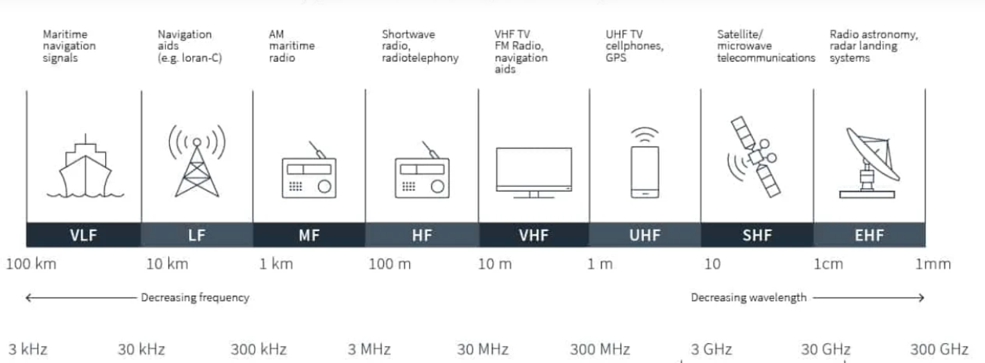
Un-guided Communications band

Slide 37
Antenna
Device used to transmit or receive electromagnetic waves.
primarily used in wireless communication systems to facilitate the transmission and reception of radio frequency (RF) signals.
Electrical device that converts electric signal into electromagnetic waves and vice-versa.
signal from a transmission line like a co-axial cable, is given to an antenna, which then converts the signal into electromagnetic energy to be transmitted through space
Antennas come in various shapes and sizes, and their design depends on the specific application and frequency range involved.

Slide 38
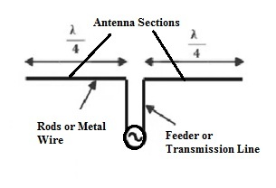
Dipole Antenna
simplest type of radio antenna, consisting of a conductive wire rod that is half the length of the maximum wavelength the antenna is to generate.
This wire rod is split in the middle, and the two sections are separated by an insulator.
Each rod is connected to a coaxial cable at the end closest to the middle of the antenna.
Radiation pattern is ominidirectional.
Used including radio and television broadcasting, wireless communication systems, and amateur radio.

Slide 39
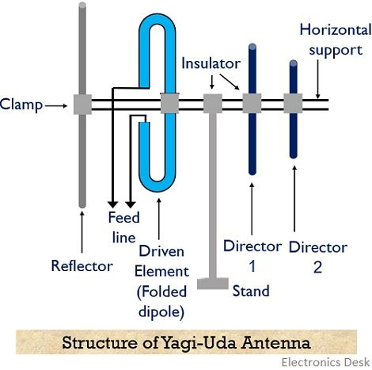
Yagi-Uda Antenna
directional antenna used for communication purposes, particularly in radio and television reception.
Consists of a active element (often a dipole) where signal is fed via co-axial cable.
multiple passive parallel elements of increasing length are arrange in same axis.
directors are shorter than the driven element and are placed in front of it, while the reflector is longer and positioned behind the driven element.

Slide 40
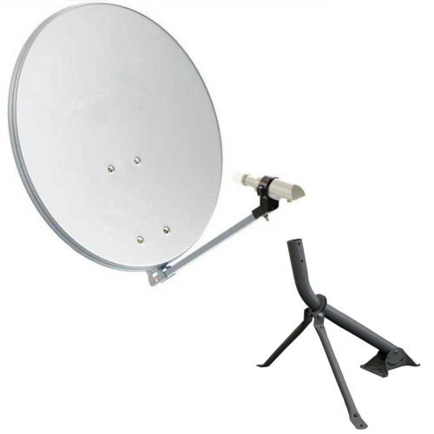
Parabolic antenna
known as a parabolic reflector or a dish antenna ( often made of aluminum or steel), used to collect and concentrate the incoming em waves at the focal point of the reflector.
feedhorn or feed antenna is located at the focal point of the parabolic reflector to collect reflected signal.
dipole at mouth of horn convert radio signal to electrical signal.
Parabolic antennas are widely used in satellite television, satellite repeater and also utilized in long-range point-to-point communication links, such as microwave links between telecommunication towers.

Slide 41
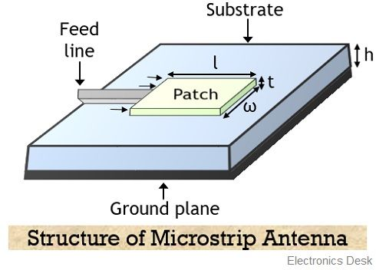
Microstrip Antenna
typically consists of a metallic patch or strip over a dielectric substrate and a ground plane on other side.
Signal is fed between patch and ground plate.
Number of such antenna are arranged in a plane to increase the directivity.
Used in Space craft applications
Used in Air craft applications
Used in Mobile communication

Slide 42
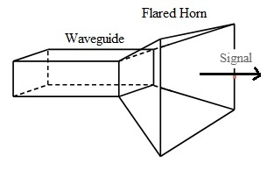
Horn Antenna
generally considered as a waveguide whose one of the ends is widened out in the shape of the horn.
used as a radiator of em wave incoming from wave guide to free space.
The widened end cause the progressive impedance matching with free space.
Used for microwave and radar applications due to its wide bandwidth, high gain and high directivity characteristics.
used as feed antenna for larger antenna structures such as parabolic antenna.

